Slide 1
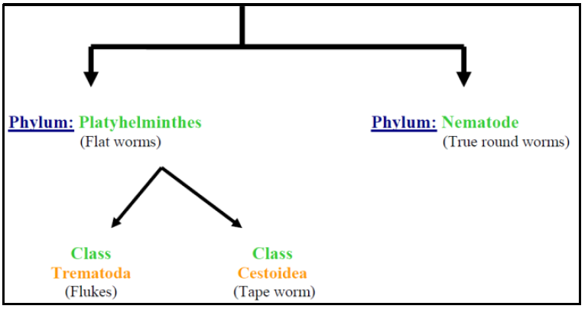
Microbiology Dep.
Second year
Parasitology
8th Lec.
Lecturer: Assist prof.
Dr. Sally Ahmed
Helminthes
The term Helminths means Worms
Helminthes
The two classes are parasitic in all or most of their life cycle stages.

Slide 2
General characters of helminthes
Helminthes are macroscopic & multicellular.
Bilaterally symmetrical.
Have special adaptations for the parasitic mode of life & for survival.
Like the complete absence of the Digestive tract or greatly reduced consist of mouth & blind sac only this is because of their location in the host intestine or tissue where predigested nutrient are abundant. In Trematodes the Digestive system is partially loss.
In Cestodes there is no Digestive system. While in Nematodes the Digestive system is complete.
There is special adaptation in Trematode & Cestode, presence of a coat of microvilli on the outer surface of the tegument for nutrient absorption.
Internal parasite possesses all sorts of adaptation like hooks, suckers, boring apparatus, etc……….
Reproductive system is very well developed. (Self-fertilization, cross fertilization may take place. They are monicious or diecious).
Eggs are produced in large numbers or few of them survive & manage to infect a suitable host.

Slide 3
Helminthes do not multiply in human body so thenumber of individuals in a worm population living within a given host does not exceed the number of infective eggs or larvae that enter from the external environment. However reproduction by autoinfection to increase parasite population occur e.g. pin worm by ingestion eggs through contaminated fingers .
Helminthes (adult worm, their eggs, larvae) can be distributed in various organs & tissues of the body.
Most of the infected people with helminthes are symptomatic carriers, and the diseased individual among the infected groups are those with heaviest worm burden.
The terms Light, moderate, heavy applied to worm burden are relative & differ for various species of helminthes and in people of different age & physical status.
The number of eggs or larvae eliminated in feces, urine, sputum is roughly proportional to the number of worms generating them.

Slide 4
(Cestodes) (tapeworms)
Phylum Platyhelminthes
Class Cestoidea
· Order 1- Pseudophyllidea: Solid form larvae
Diphyllobothrium latum
Disease: Fish tape worm infection, dipyllobothriasis

Slide 5
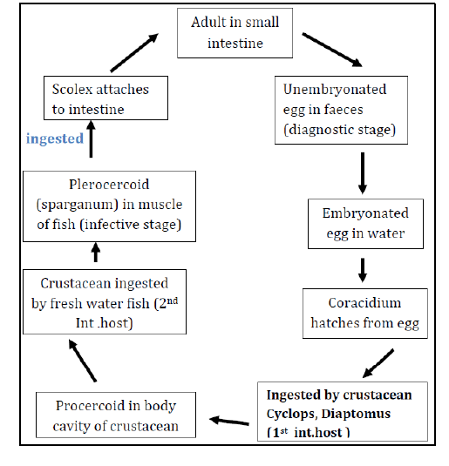
Life cycle

Slide 6
Pathogensis and symptomatology:
D. latum produce no symptom, but infection may cause digestive disturbance, diarrhea, hunger pain, nausea, anorexia, vomiting. Sudden vomiting of a portion of worm may occur. With symptoms suggesting peptic ulcer, In certain instance carriers develop Pernicious anemia,called bothriocephalus anemia.
In about 2 percent of the cases megaloblastic anemia develop .When the worm high up in the jejunum it absorbs vitamin B 12 from the intestine thus prevents its combination with intrinsic factor, blocking the absorbtion of vitamin B12 resulting in its deficiency.
Diagnosis:
Stool examination looking for eggs or segments also Immunodiagnosis.
Epidemiology:
The parasite is prevalent in central Europe. America, Japan, central Africa where raw fish are routinely consumed.

Slide 7
Order 2- Cyclophyllidea
The larval stage is bladderor cyctic, vesicular form.
1-Taenia saginata
Synonyms: Beef tapeworm, Taeniarhynchus saginata.
Disease: Taeniasis saginata.
Habitat: Adult tapeworm is attached to the wall of small intestine of man.
Morphology:
It is white tape like warm adult worm 5 meters long with
1000 -2OOO- proglottids.
• Scolex: pyriform with 4 muscular suckers, no rostellum, no hooks, there is a slight apical depression (unarmed tape worms).

Slide 8
• Strobila: neck, lmmature proglottids, mature prohglottidds, about 12 mm in width with a full set of male and female reproductive organs.
• Male & Female Reproductive organs :
Ovary, bilobed, vagina, ootype, vitellaria, behind the ovaries, blind uterus.
Testes, 300-400 follicle, vasa efferentia coiled vas deferense, cirrus, genital pore on the lateral margin of the segment.
The genital pore on the lateral margin of the segment alternate irregularly between the right & left margins. As the segments move towards the posterior end of the worm, they become more elongated & narrower (gravid seg.)

Slide 9
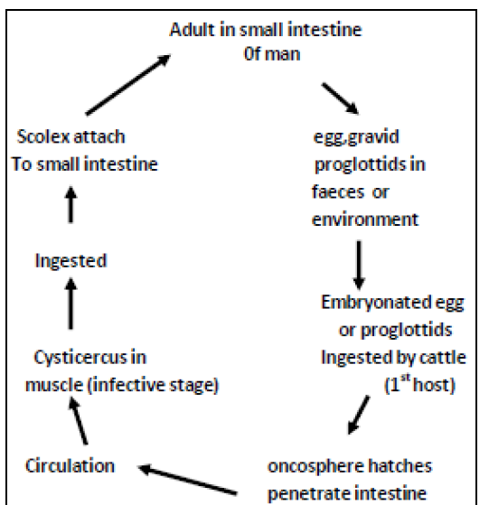
Life Cycle

Slide 10
Pathogenesis and symptomatology:
• Infection with adult T.saginata is without symptoms
• Abdominal discomfort
• Diarrhea alternate with constipation.
• Anorexia, hunger pain.
• Intestinal obstruction (rarely)
Diagnosis:
• Demonstration of proglottid or egg in faeces.
• Serodiagnosis: IHA, IFA, ElISA.
Adhesive cellophane tape technique.
Control:
1) Proper disposal of human faeces
2) Workers at cattle feed lots examined periodically for sign of infection.
3) Thorough cooking of beef before consumption, heating the meat to 65 degree centigrates is a safe guard.
4) Freezing the beef at -20 degree centigrates for 24 hours or longer kill the cysticerci.

Slide 11
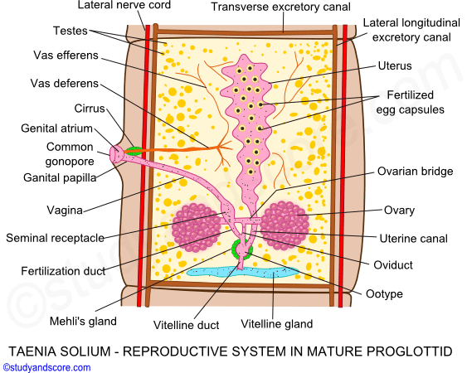
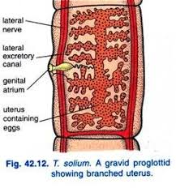
2- Taenia Solium
Pork tape worm, armed tape worm,
Disease: Taeniasis solium , pork , tapewarm infection .
Habitat: small intestine of man.
Morphology:
• 2-3 meters in length, fewer than 1000 proglottid.
• Scolex: Globular in shape, 4 suckers, of alternating large and small hooks 22 to36 in number and measuring 140 to 200 μm and 100 to 150-μm long.

Slide 12
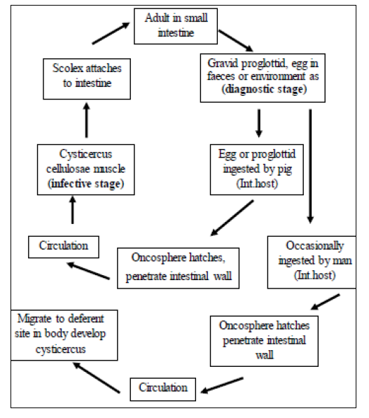
Life cycle

Slide 13
Pathogenesis and symptomatology:
Infectin with the adult T.solium produce the same clinical manifestations as infection with T.saginata. However , no intestinual obstruction.
Diagnosis:
Similar to that of T.saginata
Epidemiology:
Human infection with adult T. solium results from eating raw pork containing Cysticercus cellulosae. Man is the only natural host of the adult worm. Man is also a suitable host for the cysticercus.
Control:
Sanitary disposal of human faeces , Treatment of infected person , Thorough cooking of pork or held in a deep freeze for at least 24 hrs

